Slide 1

DriverPass System Analysis
Daniel Cervantes
Notes:
[No speaker notes required for this slide.]

Slide 2
System Requirements
Users can schedule lessons
Users can take practice tests
The system is secure
System is web-based
Notes:
This system allows students to schedule driving lessons and take practice online tests. It is designed to be easy to use and accessible from different devices. It also includes security features to protect user information and make sure only authorized users can access certain parts of the system.

Slide 3
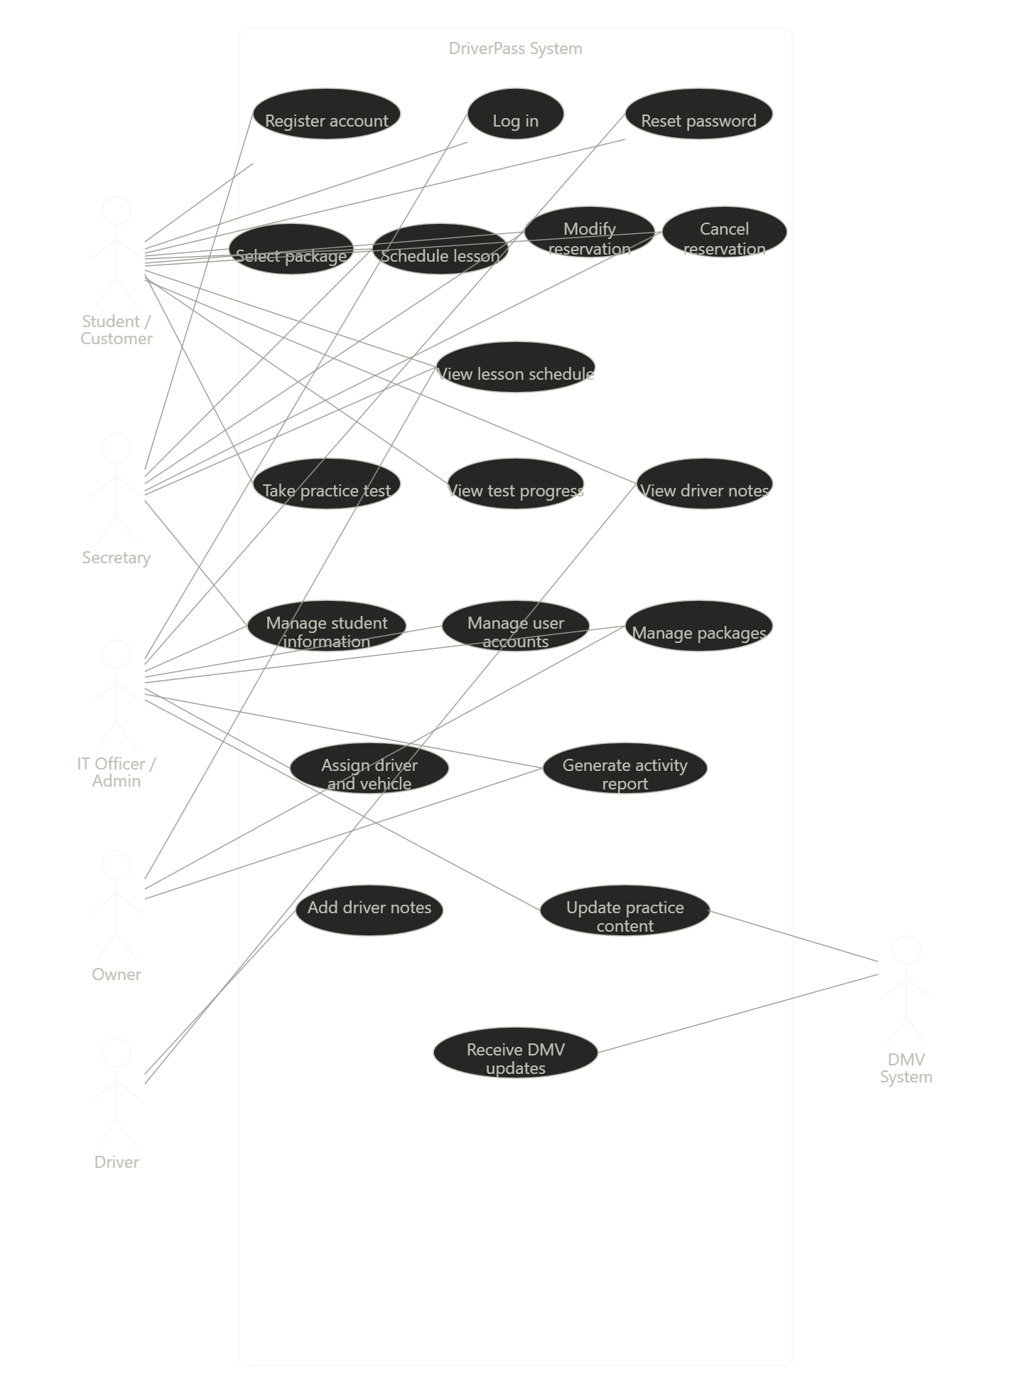
Use Case Diagram
Notes:
This diagram shows the different users who interact with the DriverPass system and the main actions they can perform. The main users include students/customers, the secretary, the IT officer/Admin, the owner, the driver, and an external DMV system. Each user has specific responsibilities based on their role in the system.
For example, students can create accounts, log in, select packages, schedule lessons, take practice tests, and view their progress. The secretary helps manage scheduling, including modifying and canceling reservations. The IT officer or admin manages user accounts, student information, packages, and system content. The owner can generate reports and oversee system activity, while drivers can add notes about lessons. The system also connects to the DMV to receive updates that help keep practice test content current. This diagram shows how each user interacts with the system to support schedules, training, and progress tracking.

Slide 4
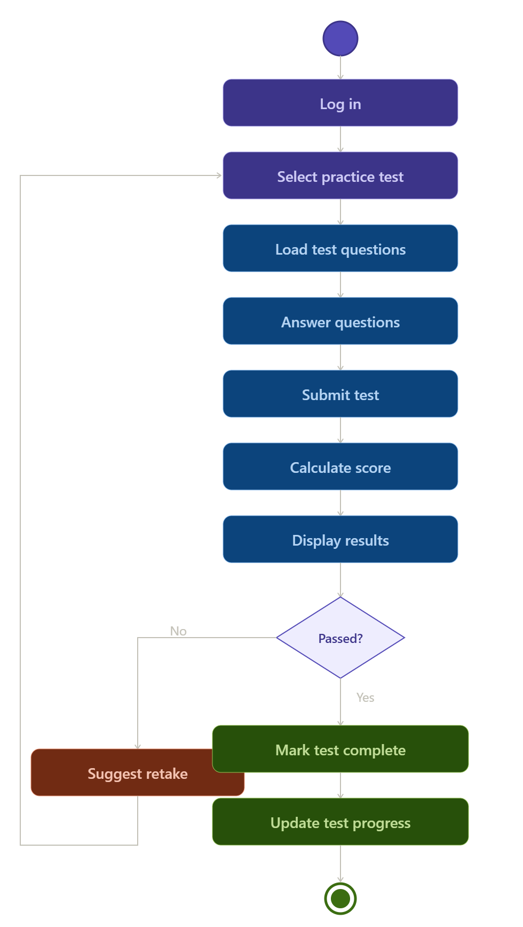
Activity Diagram
Notes:
This diagram shows the steps a student goes through when taking a practice test in the DriverPass system. First, the student logs in and selects “Practice Test”. The system the loads the test questions, and the student answers them before submitting the test. After submission, the system calculates the score and displays the results.
At that point, the system checks if the student passed or not. If the student passes, the system marks the test as complete and updates their progress. If the student does not pass, the system suggests that they retake their test. This process helps track the student’s performance and makes sure they are improving over time.

Slide 5
Security
Secure Login
Role-based access
Data protection
Notes:
The system includes security features to protect user data. User must log in, and different roles have different levels of access. This helps keep information secure and prevents unauthorized access.

Slide 6
System Limitations
Internet Required
Budget limits
Future updates needed
Notes:
The system depends on internet access and may have limits based on budget and time. Some features may be added later as the system improves.

